Slide 1
COVID-19 Relationship to Hospital Locations
By: Austin Joseph, Anna Prack, Brody Peelman, Matthew Miller

Slide 2
Introduction
Motivation - COVID-19 ran rampant when it first appeared and overwhelmed many hospitals, causing many deaths, and is still very active today.
Problem Definition:
H₀: There is no relationship between COVID-19 infection count and county hospital density.
H₁: There is a relationship between COVID-19 infection count and county hospital density.

Slide 3
Libraries used
VS Code - Python Development:
Libraries:
Pandas
GeoPandas
Matplot
R Studio / R:
Experimental deduction

Slide 4
Data Preprocessing
Tuples missing data:
When manipulating the COVID-19 Dataset for final case counts, some counties did not contain data for this field. The median was calculated for the total counts and used in place.
Normalization for color scaling:
Because the total cases variable showed heavy skewness (Most tuples were less than fifty thousand, but had large outliers like four-hundred thousand), the ‘vmax’ parameter needed adjustment. The ‘vmax’ details the maximum value of our color scale. A heavily skewed value was chosen which allowed for better visualization disparity.

Slide 5
Encoding of Data
Geopandas is used for geospatial indexing and builds spatial indexes with libraries. Pandas indexing is also used and it uses a row index.
Join Key encoding is done for merging when we want to compare “state” + “county”, they are made lowercase so they are uniform.

Slide 6
Query Processing Algorithms
Transforms raw COVID-19 dataset of detailed cases by date, per county into dataset with total cases by county:
Load into Pandas
Group by ‘state’, ‘county’
Clean the data into final case counts by last date entry
Output by .CSV

Slide 7
Query Processing Algorithms
Combine ‘total_cases’ dataset with shapefile containing counties FIPS codes and geographic coordinates:
Load dataset into Pandas, shapefile into GeoPandas
Cleaning missing tuple values
Merge upon ‘state’, ‘county’ and FIPS/ Latitude and Longitude via left join
Normalize visual scaling via ‘vmax’ attribute
Output DataFrame to be converted to choropleth graph

Slide 8
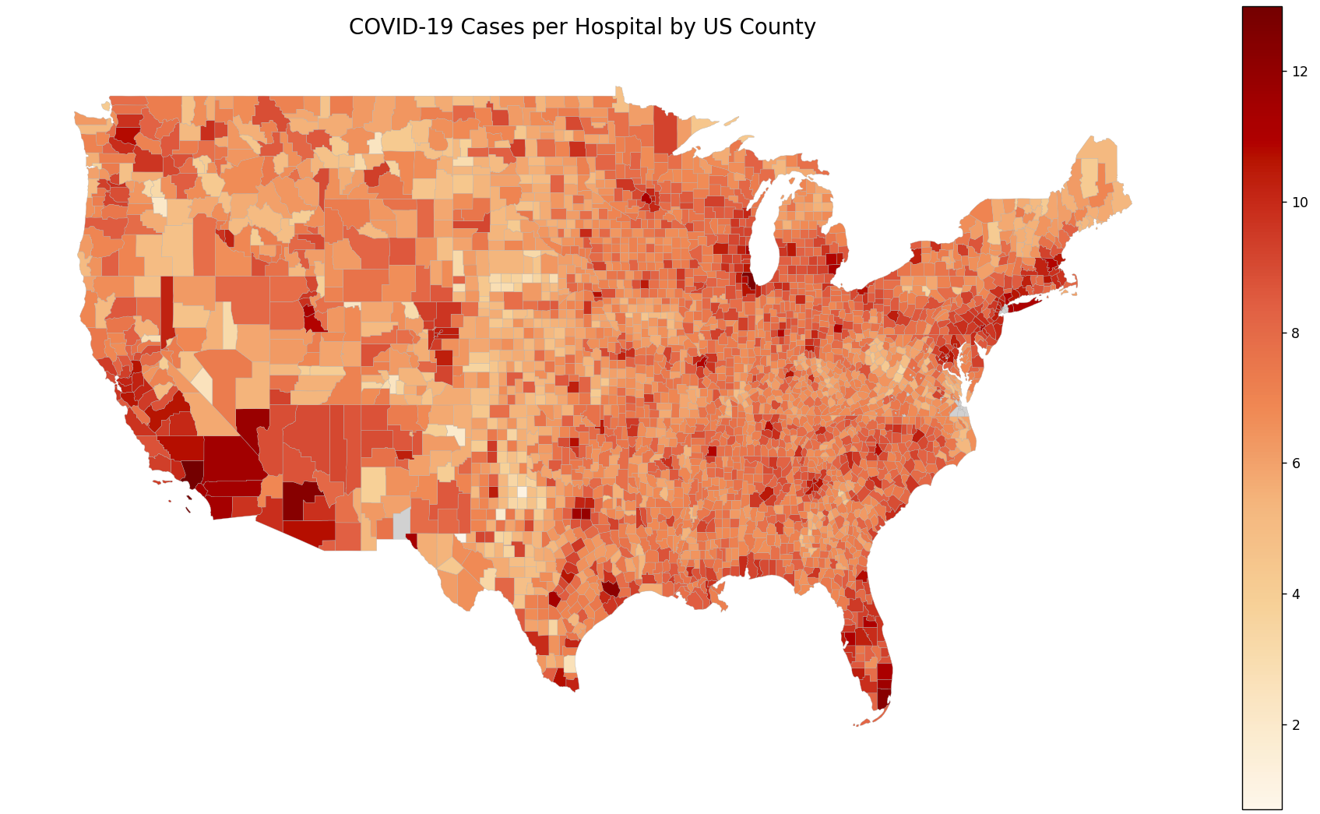
Data Visualization
Shows number of COVID-19 cases divided by number of hospitals in each county
The more COVID-19 cases per hospital, the more red
Shows that some places have significant differences in this ratio

Slide 9
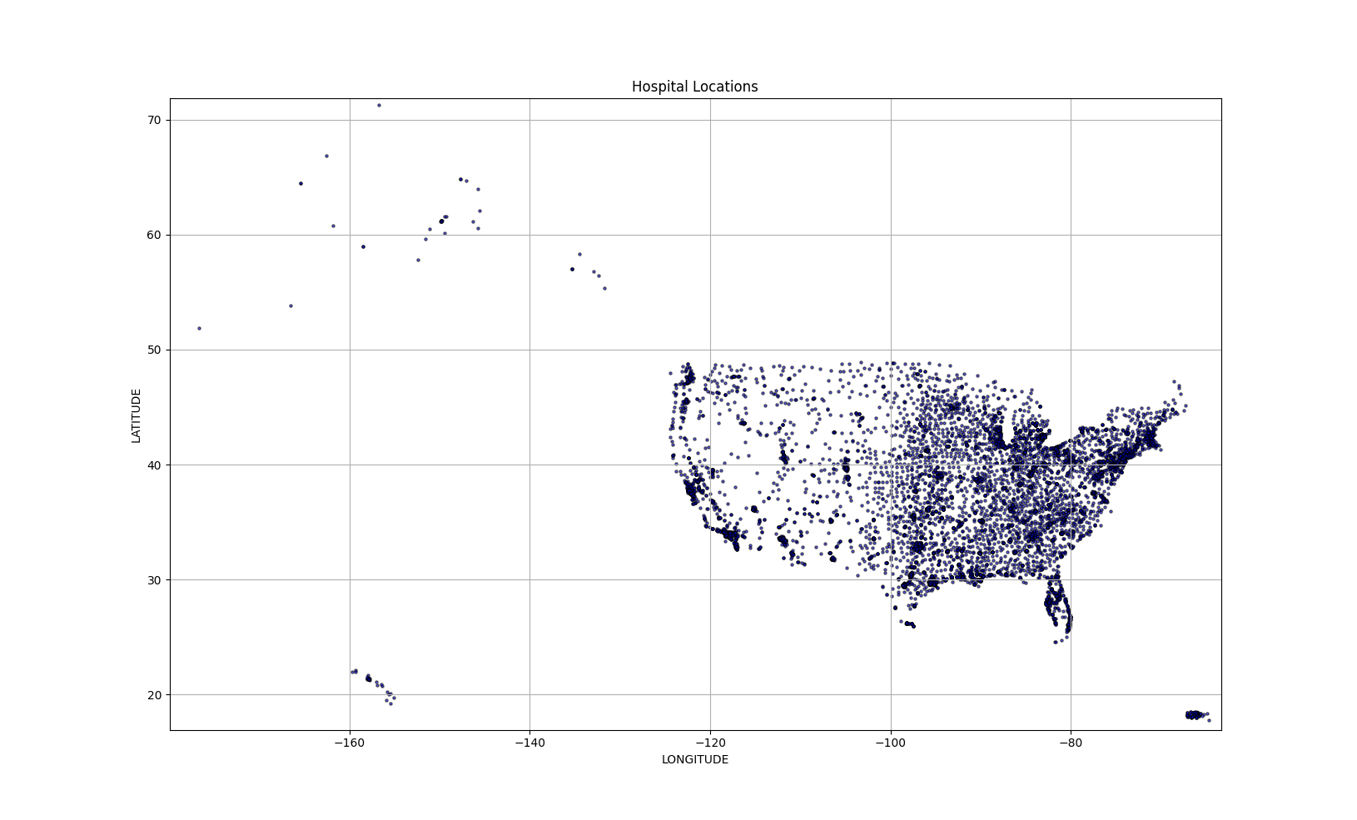
Data Visualization
Each dot on this map represents a hospital in the United States
Helps see where hospitals are concentrated most

Slide 10
Hypothesis Testing and Results
Hypotheses:
H₀: There is no relationship between COVID-19 infection count and county hospital density.
H₁: There is a relationship between COVID-19 infection count and county hospital density.

Slide 11
R preprocessing
hospital_data <- read_csv("data/Hospitals_gdb_771050112109123987.csv") covid_data <- read_csv("data/total_cases_by_county.csv") hospital_density <- hospital_data %>% count(COUNTYFIPS, name = "hospital_count") covid_data <- covid_data %>% mutate(COUNTYFIPS = as.character(COUNTYFIPS)) hospital_density <- hospital_density %>% mutate(COUNTYFIPS = as.character(COUNTYFIPS)) combined_data <- covid_data %>% inner_join(hospital_density, by = "COUNTYFIPS")

Slide 12
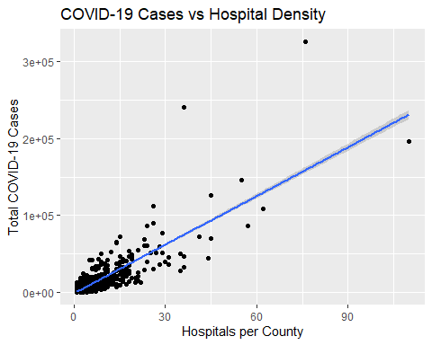
Linear Model Visualization
ggplot(combined_data, aes(x = hospital_count, y = total_cases)) + geom_point() + geom_smooth(method = "lm", se = TRUE) + labs(title = "COVID-19 Cases vs Hospital Density", x = "Hospitals per County", y = "Total COVID-19 Cases")

Slide 13
Linear model
model <- lm(total_cases ~ hospital_count, data = combined_data) summary(model)
## ## Call: ## lm(formula = total_cases ~ hospital_count, data = combined_data) ## ## Residuals: ## Min 1Q Median 3Q Max ## -47729 -1047 -94 913 166560 ## ## Coefficients: ## Estimate Std. Error t value Pr(>|t|) ## (Intercept) -1392.9 171.2 -8.139 6.46e-16 *** ## hospital_count 2113.8 27.5 76.872 < 2e-16 *** ## --- ## Signif. codes: 0 '***' 0.001 '**' 0.01 '*' 0.05 '.' 0.1 ' ' 1 ## ## Residual standard error: 7244 on 2318 degrees of freedom ## Multiple R-squared: 0.7183, Adjusted R-squared: 0.7181 ## F-statistic: 5909 on 1 and 2318 DF, p-value: < 2.2e-16

Slide 14
Confidence interval
confint(model)
## 2.5 % 97.5 % ## (Intercept) -1728.561 -1057.303 ## hospital_count 2059.846 2167.690
Based on our data and our calculations, we’re 95% sure that the actual relationship between hospital count for a county and number of COVID-19 cases in 2020 is a coefficient of between 2059.846 and 2167.690 cases per hospital. This range is positive and does not include 0, so we’re confident that there is a significant positive relationship between the two variables.

Slide 15
Hypothesis Testing and Results
Hypotheses:
H₀: There is no relationship between COVID-19 infection count and county hospital density.
H₁: There is a relationship between COVID-19 infection count and county hospital density.

